Slide 1

Robot Operating System
Ir Dr zool hilmi Ismail & INNOKAI TEAM

Slide 2
OUR SCHEDULE
Session 1 : Revision and Simple Command on Linux
Quick Flashback on Phase 1
Session 3: Python and ROS
Task Given, Creating package, workspace
Introduce some useful command in Linux
Learn how to start the master node in ROS
Connect Raspberry Pi on turtlebot to laptop via wifi
Configure workspace in bashrc
Introduction to rostopic
Session 2: Introduction to Python
Learn the basic of python
Some exercises to test programming skills
# DAY 1

Slide 3
OUR SCHEDULE
Session 4: Continue on ROS topic
Introduction to node and messages
Session 6: Camera and sensor implementation on Turtlebot3
Introduction to OpenCV (camera and image processing)
Session 5: Hands on Python and ROS
Introduction to publisher, subscriber, server, action
Learn how to implement topic
Understand ROS node and messages and its usage
Learn to code and command related to ROS
Other sensors (slam mapping)
Code will be implement in turtlesim (a simple simulation before Turtlebot3)
# DAY 2

Slide 4
OUR SCHEDULE
Session 7: OpenCV
Capturing an Image in OpenCV
Session 9: Demo
Show what turtlebot can do from Team Innokai
Session 8: Code Implementation in Turtlebot3
Introduction to twist messages, mapping
Launch example Gazebo world
Teleoperation
# DAY 3

Slide 5
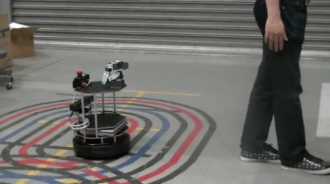
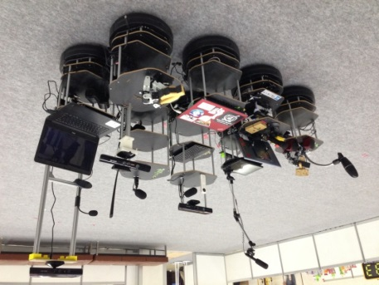

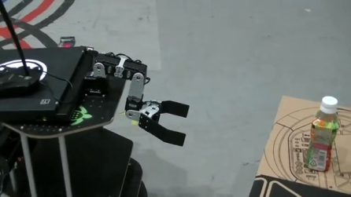
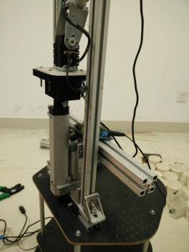
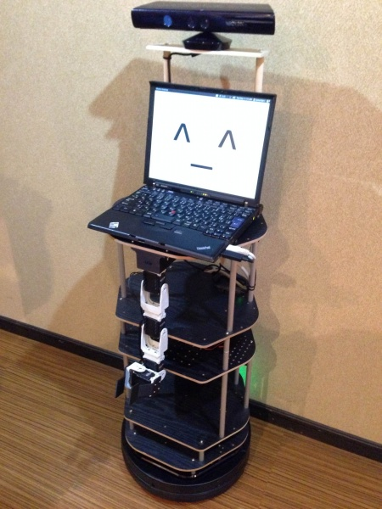
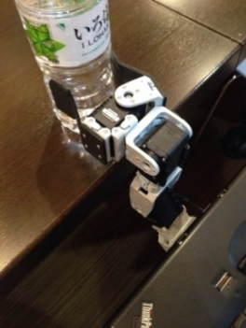
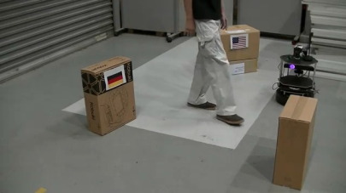
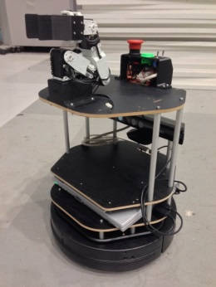
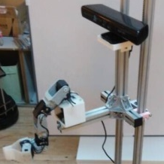
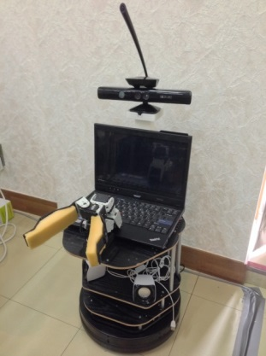
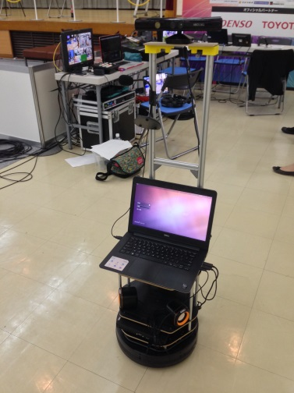
Educational Open Robot Platform for AI Service Robot
RoboCup@Home
E D U C A T I O N
MOTIVATION
The development curve of service robot has a very steep start
High cost, manpower and development time
Multidisciplinary research themes
For education
Educational platform for RoboCup@Home Education
Standard startup platform for new participation
Open source to share participants development for overall improvement
Evolving through the competition cycle
SPECIFICATION
User Interface
Digital I/O
Android interface
Iconic facial expression
Software framework
Navigation
Manipulation
Voice Interaction
People/object recognition
Mobile Base
TurtleBot2 (Kobuki)
Perception Systems
Kinect for Xbox 360
Robot Arm
TurtleBot Arm
Elevated Platform
APPROACH
Open source platform for service robot: startup base, cost effective and community support
Basic robot platform
Modular add-ons

Slide 6

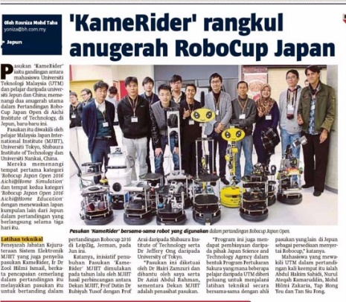
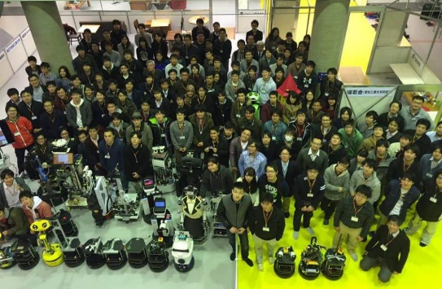
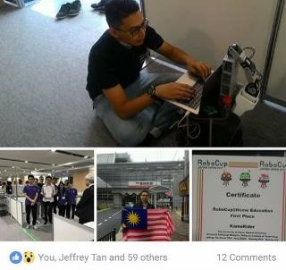
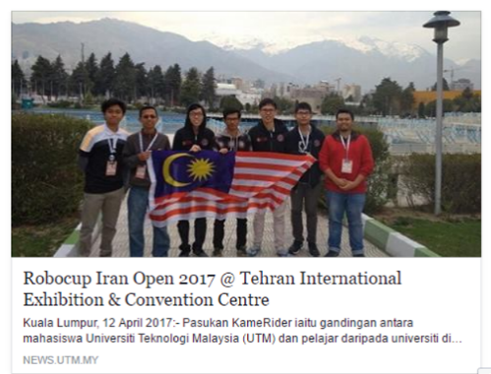
PREVIOUS AND CURRENT COMPETITIONS
INNOKAI UTM students involving in various robocup@home challenges:
2015.11.28 Intelligent Home Robotics 2015, Tokyo
2016.03.24 RoboCup Japan Open 2016 Aichi
2016.06.28 RoboCup 2016 Leipzig
2017.04.02 RoboCup Iran Open 2017, Tehran
2017.05.25 RoboCup Japan Open 2017, Nagoya
2018.06.16 RoboCup 2019, Montreal
2018.11.07 Robocup Iran Open 2019, Kish Island
2019.05.02 Robocup Asia Pacific 2019, Tianjin
….
OPEN SOURCE
Building up a community-driven development effort for service robot
Support wiki: http://openbotics.org/innokai/
Source codes: https://github.com/innokai/
www.robocupathomeedu.org
Zool Hilmi Ismail | Universiti Teknologi Malaysia | zool@utm.my
RoboCup@Home Education Organizing Committee

Slide 7
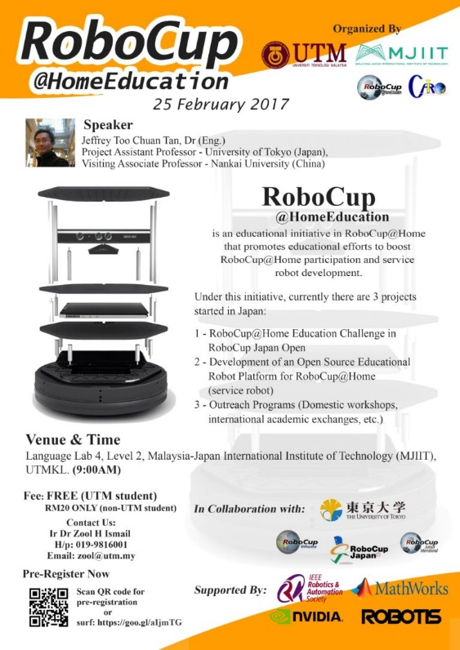
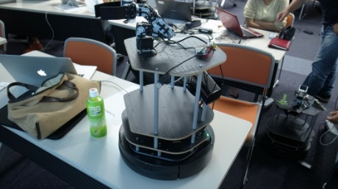













Social Outreach
WORKSHOP
Innokai workshop for RoboCup@Home Education
2017.02.25 Introduction to ROS and TurtleBot2
2017.09.04 RoboCup@Home Challenge with TurtleBot2
2018.05.28 “Grab a bottle” with TurtleBot2
2018.05.16 “Follow me” with TurtleBot2
Participated by
Supported by

Slide 8

LET'S START CODING… SESSION 1

Slide 9
Navigation ROS File System
rospack
roscd
rosls
How to autocomplete for package name, etc

Slide 10
Creating a ROS package
The simple possible package structure
List down the step of creating a ROS package
Where is the package supposed to be installed at?
What does catkin_make do and where should this be done?
How many workspace we can have in one PC?
How to source workspace

Slide 11
Packages
catkin_create_pkg <xxx> [xxx] [xxx] [xxx]
How to install packages?
From github
From terminal

Slide 12
Task
Create a workspace in home
Workspace name is innokai_workshop_ws
Create a package with stds_msgs, rospy and roscpp
Package must be ros_basic

Slide 13
Getting into Linux

Slide 14
Common command in Linux
CTRL + Alt + T - Bring out terminal
cd – change directory
ls - listing all the segments in your current directory
source – source the workspace or the libraries
clear – clear the terminal
Highlight and middle click shortcut for copy paste
CTRL + C – Stop process
CTRL + Z – Stop python code

Slide 15
Installation of packages and libraries
sudo apt-get install <package_name>
*for ros sudo apt-get install ros-<distro>-<package_name>
From Github
Git clone into src folder in workspace

Slide 16
Similar Linux Command with ROS Command
roscd = ros + cd
rosls = ros + ls

Slide 17
Introduction to Python
Session 2

Slide 18






Programing Languages in ROS

Slide 19


Slide 20
Basic of Programming
Pseudo Code
A simple description of a computer algorithms using a combination of natural language and programming language.
In other words, this is description of your code before you start coding
Flowchart
Flowcharts are written with program flow from the top of a page to the bottom

Slide 21
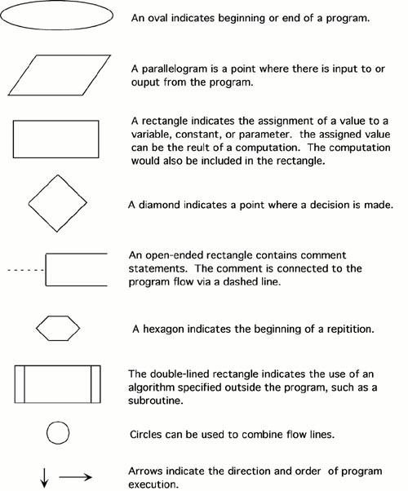

Slide 23
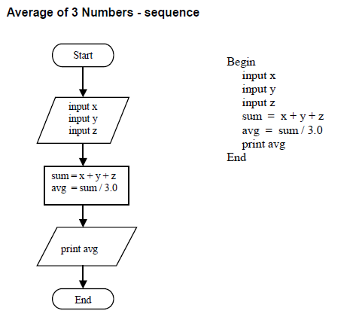

Slide 24
Basic of Python
Classes
Function
Variable
Loop
Mathematical operationn

Slide 25
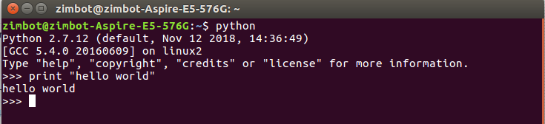
First Try in Python Programming
HELLO World

Slide 26
Types of Data
String
Char
Number
Float
Double
Int
Boolean

Slide 27
String
A set of char (character)
Define by < “” > or < ‘’>
Example
“hello world” or ‘hello world’
Joining strings together
Print (‘hello” , “world’)
Print(“hello” + “world”)
“hello %s” % (“world”)
*%s is known as a format specifier

Slide 28
Numbers
There are several types of number can be defined
Float – number with decimal values
Int – integer number
Complex number

Slide 29
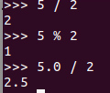
Basic Math Operator
+ - / *
% modulus
% display remainder
Example

Slide 30
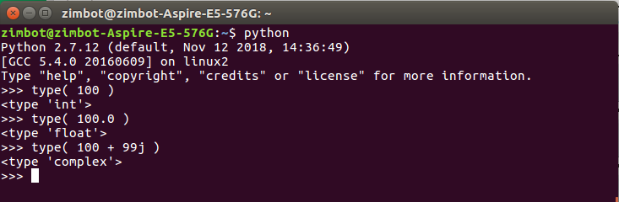

Slide 31
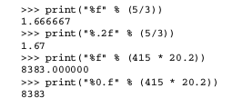
%f Format Specifier

Slide 32
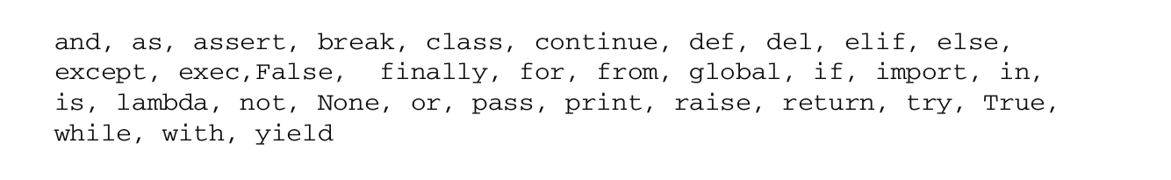
Names for Data
Cannot begin with numbers and most non - alphabet characters
*underscore is special case but avoid at first
Join words with underscore
Example – food_name , Triangle_area_calculated
Restricted name

Slide 33
Tuples vs Lists
Tuples Example
string_tuple = (‘string”, “and”)
Lists Example
string_tuple = [‘string”, “and”]
Both are similar
Difference is Tuples is fixed and cannot be change.
Adding and removing values are not possible because it is immutable
Lists can be changed
Both data can be accessed easily by string_tuple[x]

Slide 34
Special Function to deal with list and tuples
Count start from 0, 1, 2, 3, ……
Example
string_tuple = [“string”, “and”]
string_tuple[0] will be “string”

Slide 35
Dictionaries
Example
menu_specials = {“breakfast” : “sausage and eggs”,
“lunch” : “split pea soup and garlic bread”,
“dinner”: “2 hot dogs and onion rings”}
menu_specials is the name of dictionaries
“breakfast”
“sausage and eggs”
Imagine this as a book, title, chapters, content

Slide 36
Treating String like list
Name = “Brian”
Name[0] will be the first character “B”

Slide 37
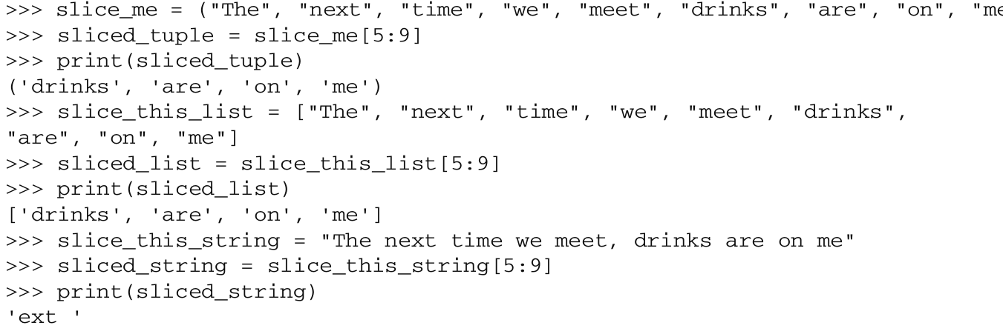
Slicing Sequences

Slide 38
Comparison
Equal to ==
Not equal to !=
Greater than >
Less than <
Greater or equal >=
Less or equal <=
Result in boolean (True or False)

Slide 39
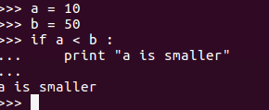
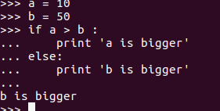
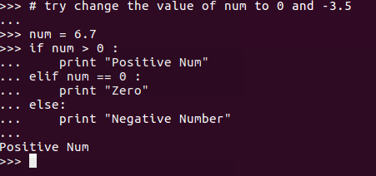
Python if...else Statement

Slide 40
Looping
for val in sequence:
Body of for
while test_expression:
Body of while
While loop
For Loop
n = 10
# initialize sum and counter
sum = 0
i = 1
while i <= n:
sum = sum + i
i = i+1 # update counter
# print the sum
print("The sum is", sum)
# Program to find the sum of all numbers stored in a list
# List of numbers
numbers = [6, 5, 3, 8, 4, 2, 5, 4, 11]
# variable to store the sum
sum = 0
# iterate over the list
for val in numbers:
sum = sum+val
# Output: The sum is 48
print("The sum is", sum)

Slide 41
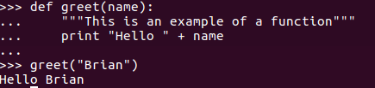
Function
def greet(name):
"""This function greets to
the person passed in as
parameter"""
print("Hello, " + name + ". Good morning!")
def function_name(parameters):
"""docstring"""
statement(s)
You may use function to return a value

Slide 42
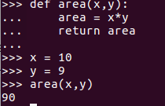
Task
Create a function to calculate the difference of these two sets of data
A = ( 9, 8, 7)
B = (10, 2, 5)
Display the result

Slide 43
EXCERCISE
TASK #1
Assign the following value to a list, tuple and dictionaries
group_1 = “zool”, “Lim”, “Brian”
group_2 = “zool”, “UTM”, “Innokai”
Num_1 = 5
Num_2 = 10
twist’s key= “x”, “y”, “z”
twist’s value = 2.0, 0.0, 0.0
TASK #2
Calculate the sum, difference, multiple and division of Num_1 and Num_2

Slide 44
EXCERCISE
TASK #3
Compare two group (group_1 and group_2), display if similar name is found
Use loop (while loop or for loop are accepted)
TASK #4
Implement all the previous into two functions
def name_comparator(group_1,group_2):
def calculation(num_1,num_2):

Slide 45
Putting Code into a .py File
Add the following the first line
#!/usr/bin/env python
For main function
if__name__== "__main__”

Slide 46
Python & ROS
Session 3

Slide 47
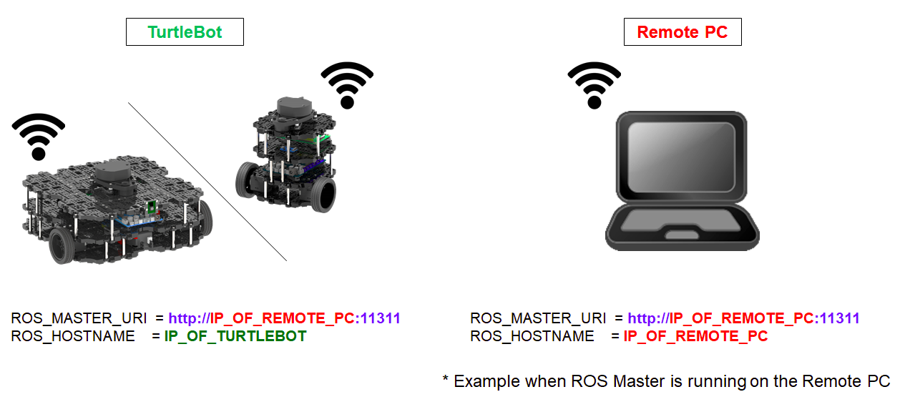
Connect turtlebot3 via WIFI with remote PC
* Uniform Resource Identifier

Slide 48
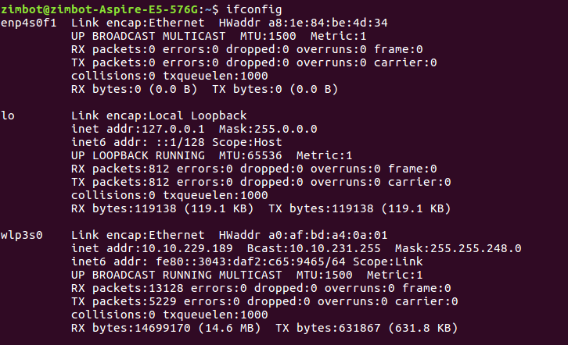
>> ifconfig

Slide 49
Export TURTLEBOT3_MODEL
In the terminal:
gedit ~/.bashrc
Inside the opened text file, write the following:
export TURTLEBOT3_MODEL=burger
export TURTLEBOT3_MODEL=waffle
export TURTLEBOT3_MODEL=waffle_pi

Slide 50
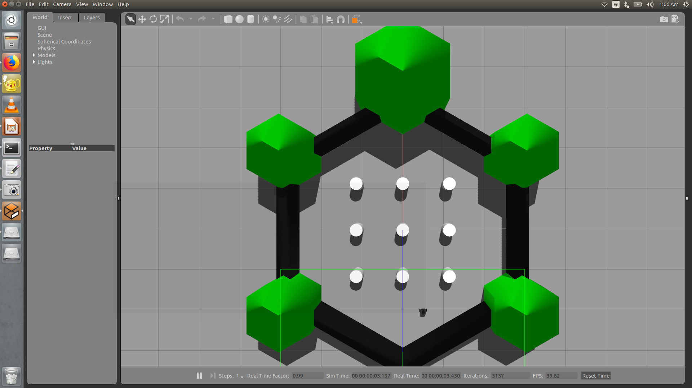
rostopic
roslaunch turtlebot3_gazebo turtlebot3_world.launch

Slide 51
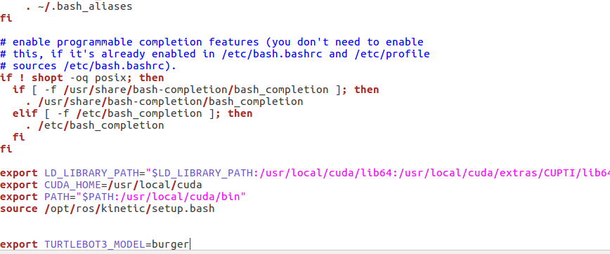
End of the file

Slide 52
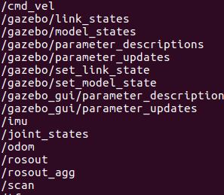
rostopic list

Slide 53
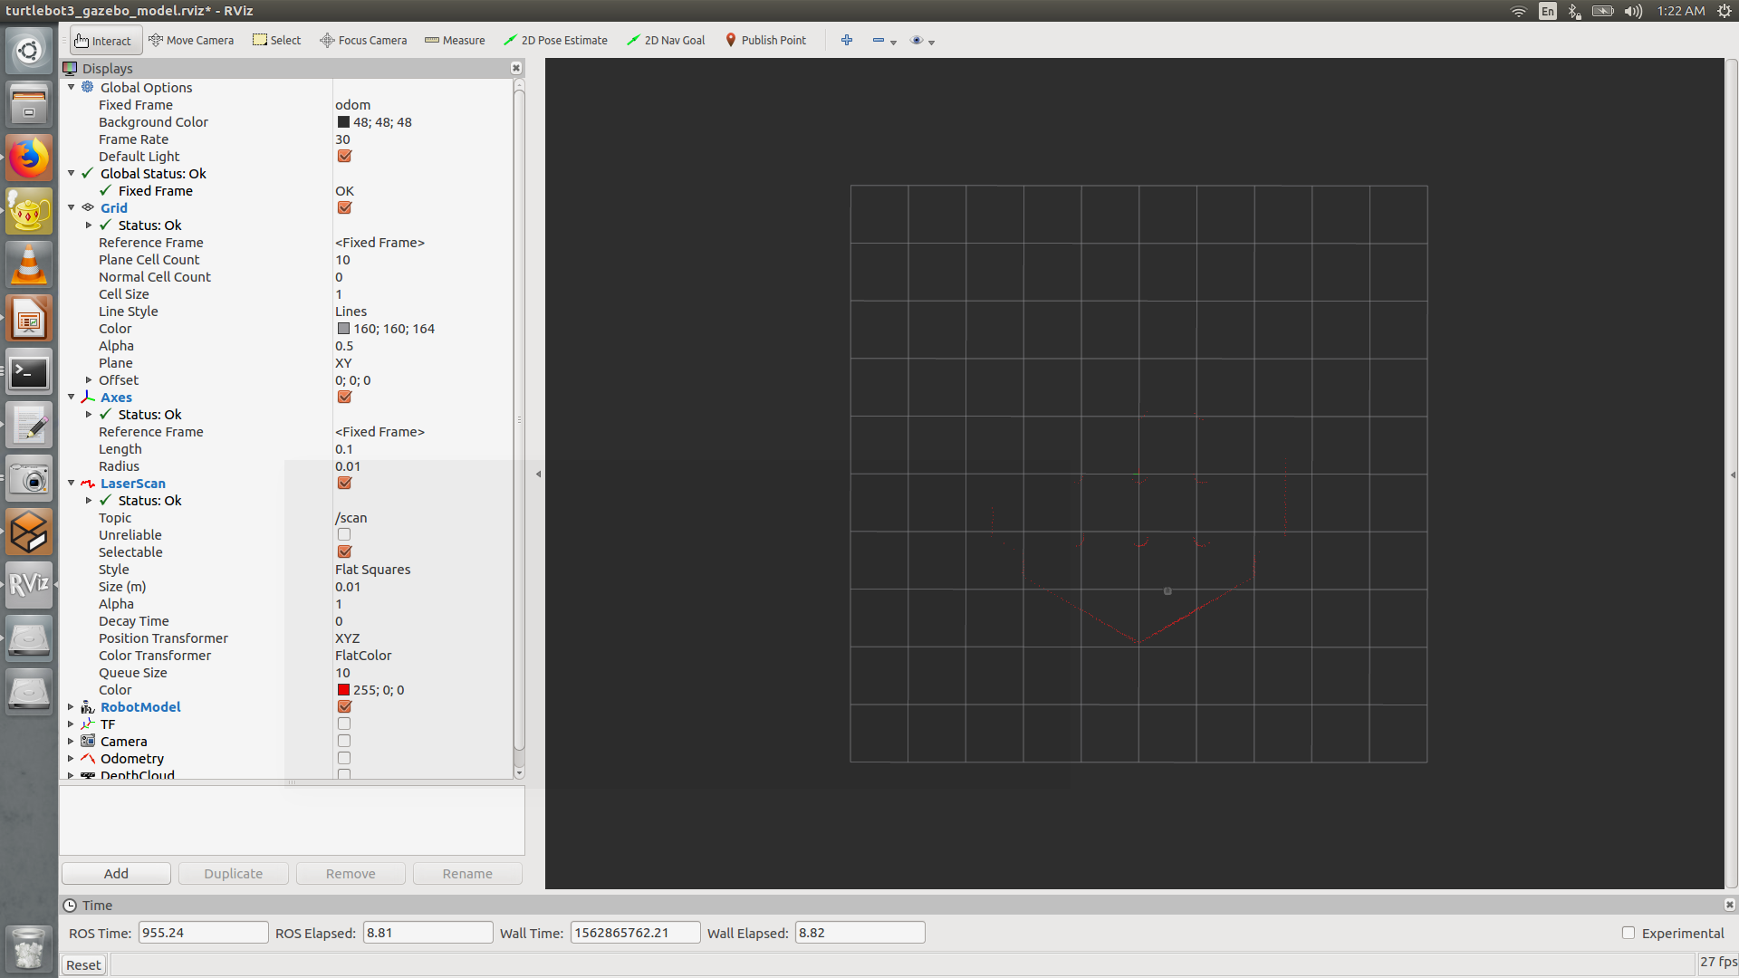
rviz
roslaunch turtlebot3_gazebo turtlebot3_gazebo_rviz.launch

Slide 54
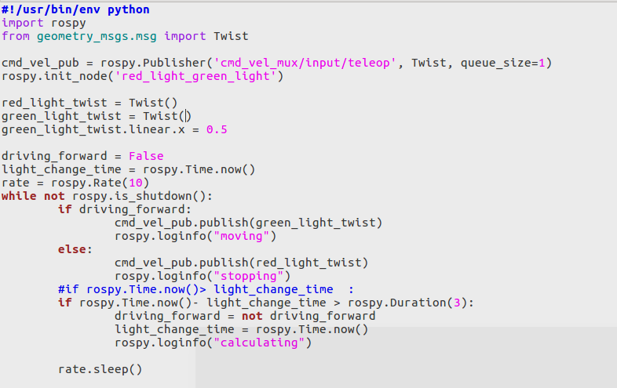
PYTHON IN ROS

Slide 55
End of DAY 1
See you tomorrow

